Slide 1
Organic Chemistry
is Everywhere!

Slide 2
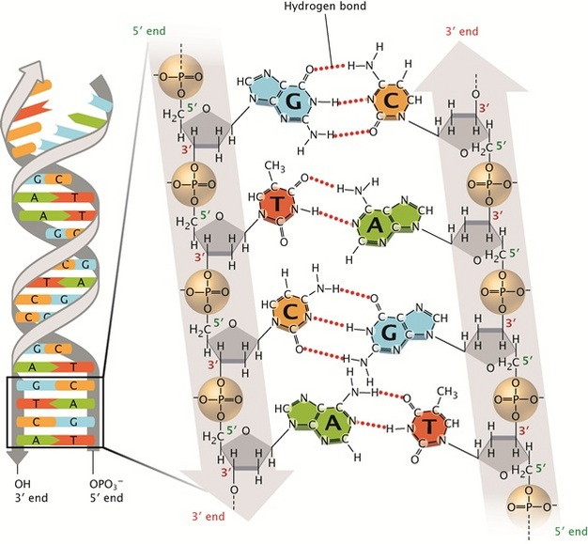
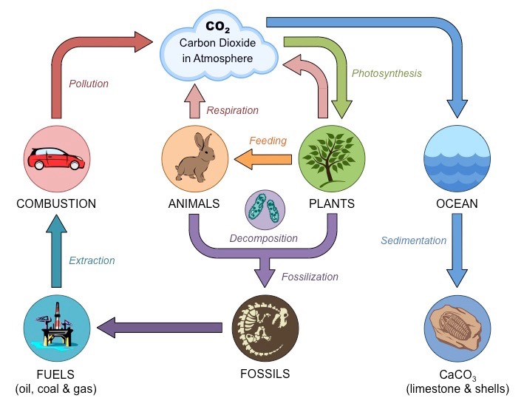
Organic Compounds form the Backbone of Our Existence and Wellbeing

Slide 3
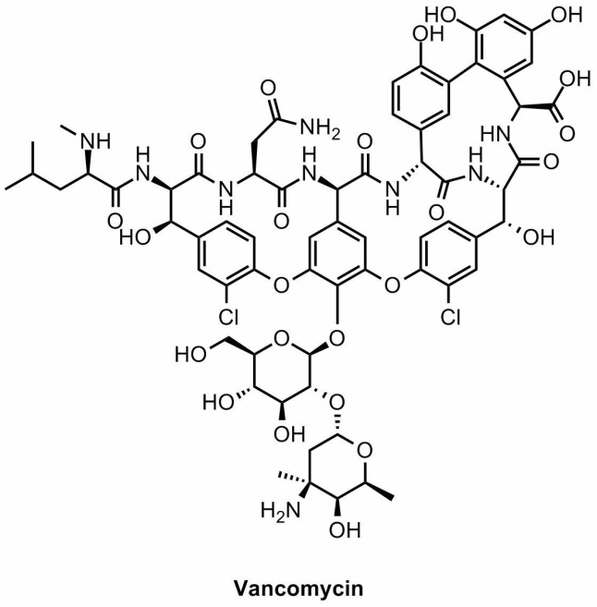

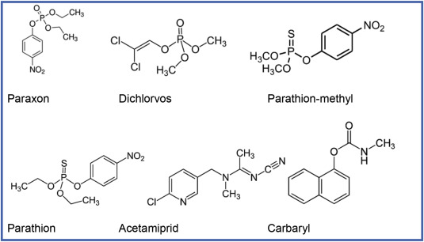
Organic Compounds form the Backbone of Our Existence and Wellbeing
Vancomycin
(Antibiotic of Last Resort)

Slide 4
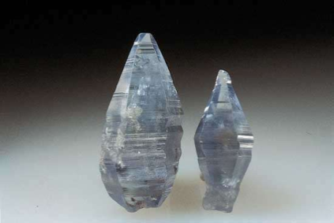

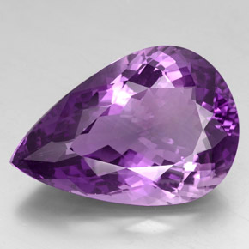

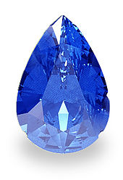

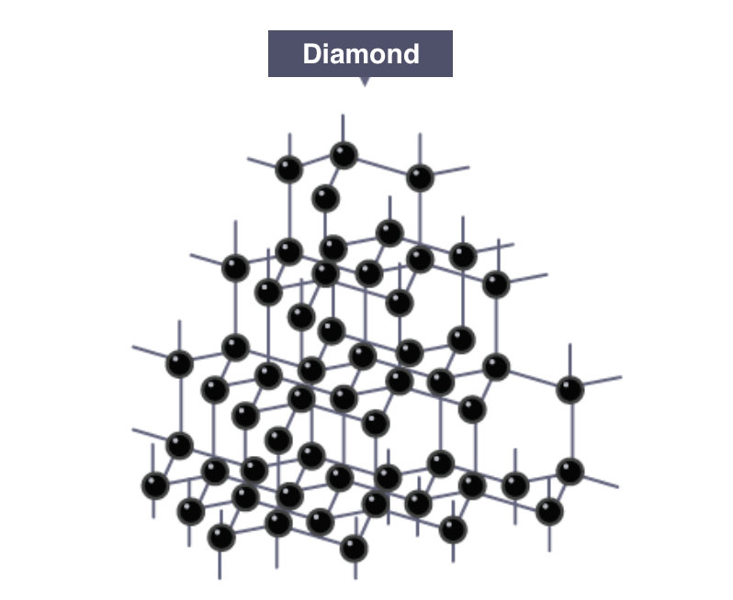
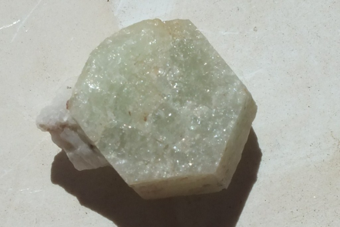
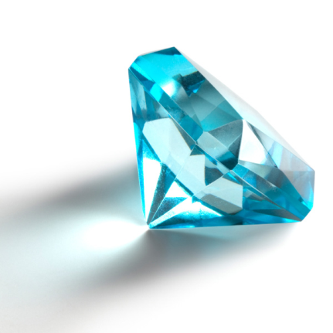
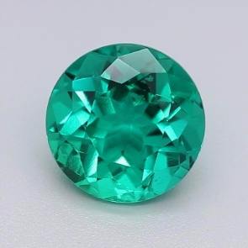
Organic Chemistry Has its Own Gemstone
We have seen these before….
Corundum Mineral
Al₂O₃
Ruby
Cr  Al
Amethyst
Mn  Al
Topaz
Fe  Al
Sapphire
Ti &Co  Al
Beryl mineral,
Be₃ Al ₂Si₆O₁₈
Aquamarine
Fe  Al
Emerald
Cr  Al

Slide 5
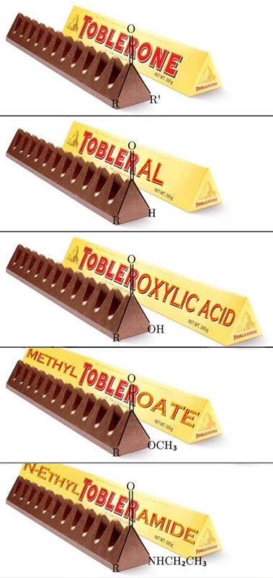
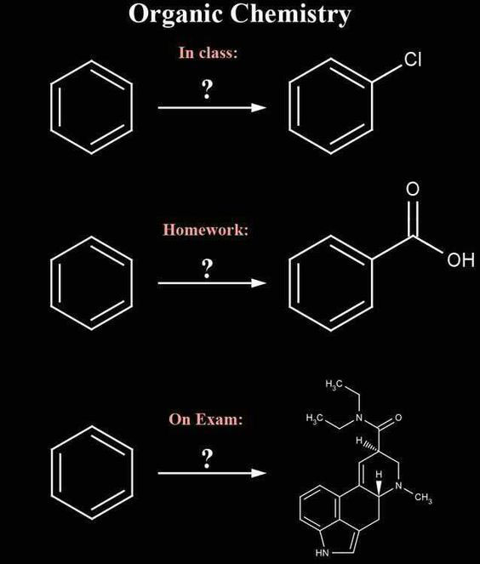
Organic Chemistry Musings

Slide 6
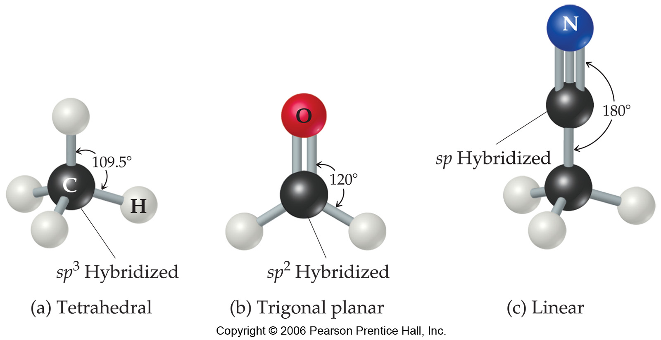
Bonding and Structure of Organic Molecules
There are three hybridization states and geometries found in organic compounds:
sp³ Tetrahedral
sp² Trigonal planar
sp Linear

Slide 7
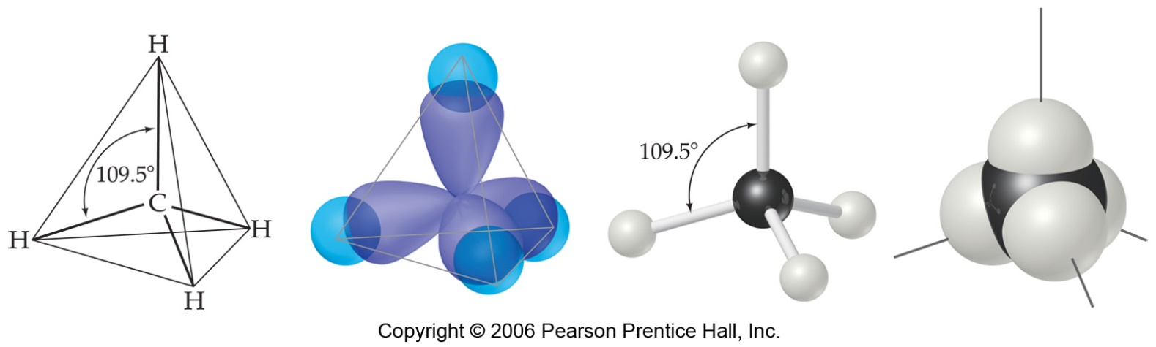
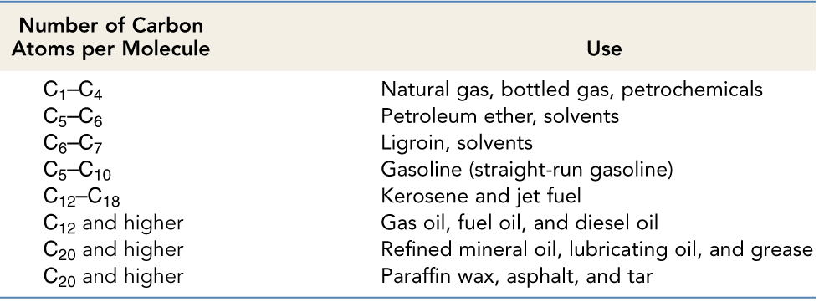
Bonding and Structure of Alkanes
Carbons in alkanes are sp³ hybrids.
They have a tetrahedral geometry and 109.5° bond angles.
Hydrocarbons from Petroleum

Slide 8
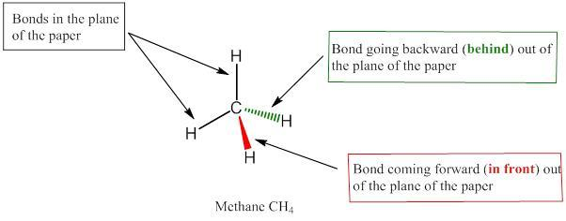
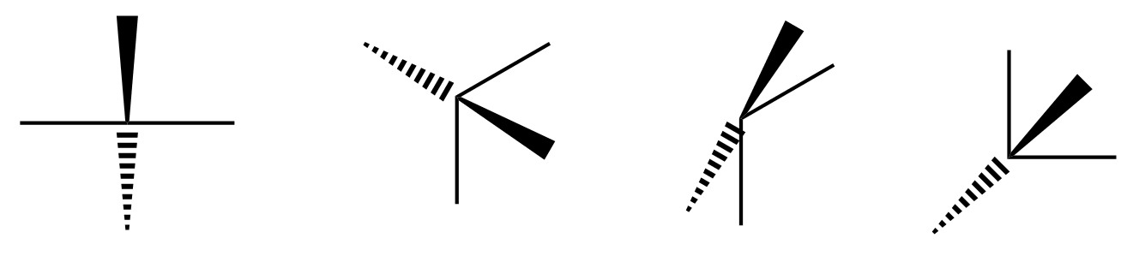
The Wedge-Dash Notation for Tetrahedral Structure
Two bonds in the plane of the paper.
One going behind the plane of the paper
One coming “outward” from the plane of the paper towards you.
To depict a tetrahedron correctly, the bonds in the plane of the paper should be adjacent to each other.
The figure below shows some INCORRECT ways of drawing!
Drawing the wrong way can lead to wrong configurations!.
INCORRECT WAYS OF DRAWING

Slide 9
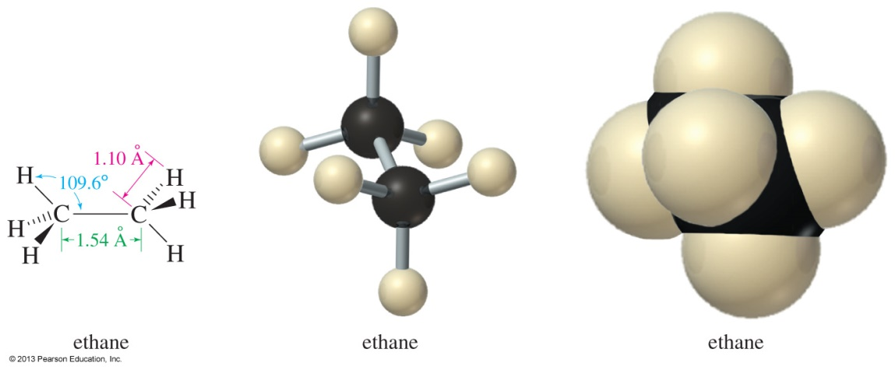
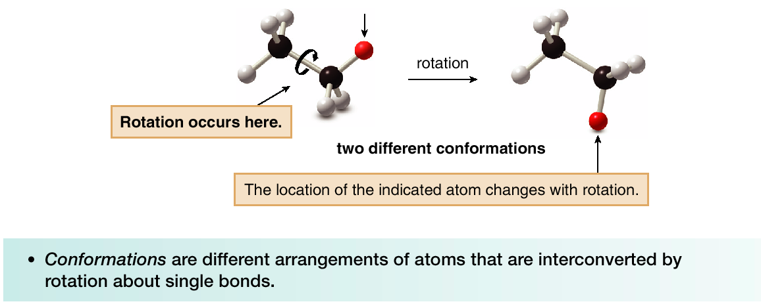
The Ethane Molecule
Two sp³ hybrid carbons.
Rotation about the C—C sigma bond can occur.
Conformations are different spatial arrangements of atoms in a molecule that are interconverted by rotation about single bonds.

Slide 10
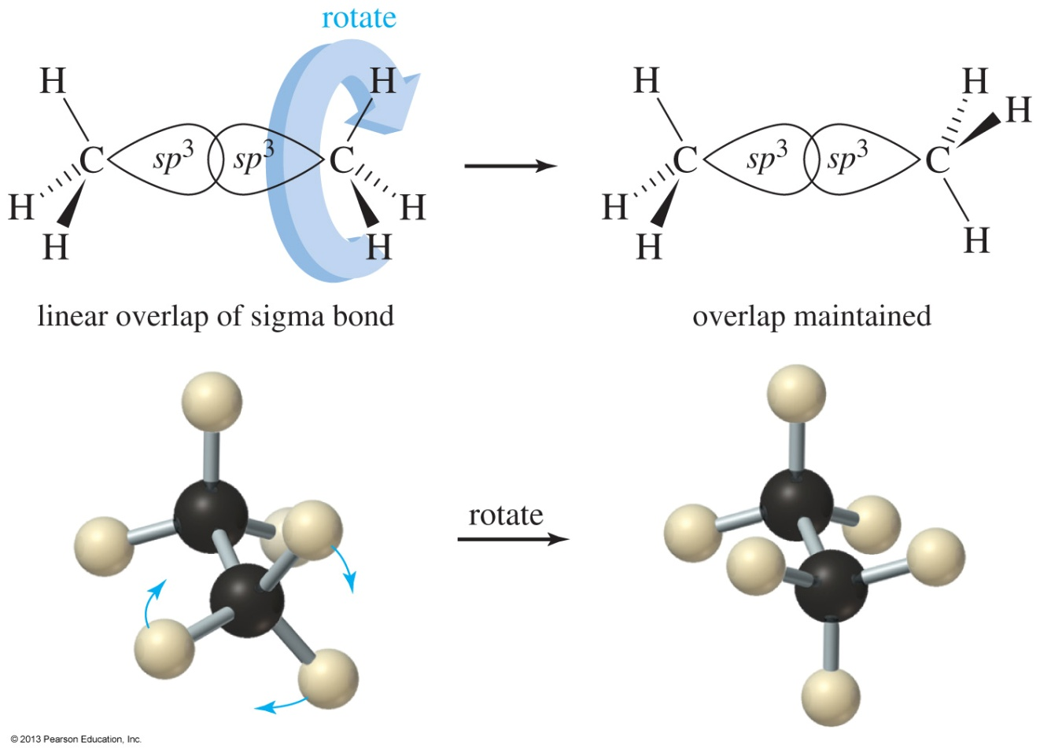
Conformations of Ethane
Pure conformers cannot be isolated in most cases, because the molecules are constantly rotating through all the possible conformations.

Slide 11
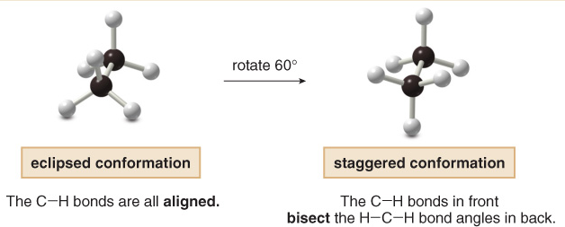
Conformations of Ethane
Names are given to two different conformations.
In the eclipsed conformation, the C—H bonds on one carbon are directly aligned with the C—H bonds on the adjacent carbon.
In the staggered conformation, the C—H bonds on one carbon bisect the H—C—H bond angle on the adjacent carbon.

Slide 12
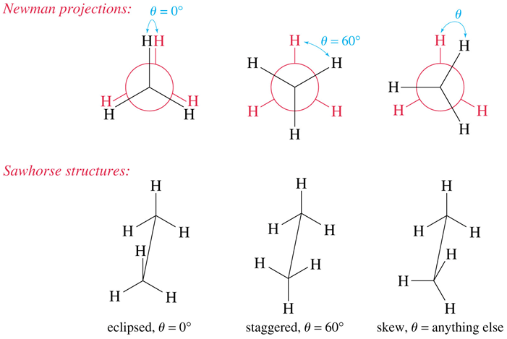
Terminology
Conformations - Different spatial arrangements that a molecule can adopt due to rotation about sigma bonds.
Staggered - A low energy conformation where the bonds on adjacent atoms bisect each other (60º dihedral angle), maximizing the separation.
Eclipsed - A high energy conformation where the bonds on adjacent atoms are aligned with each other (0º dihedral angle).

Slide 13
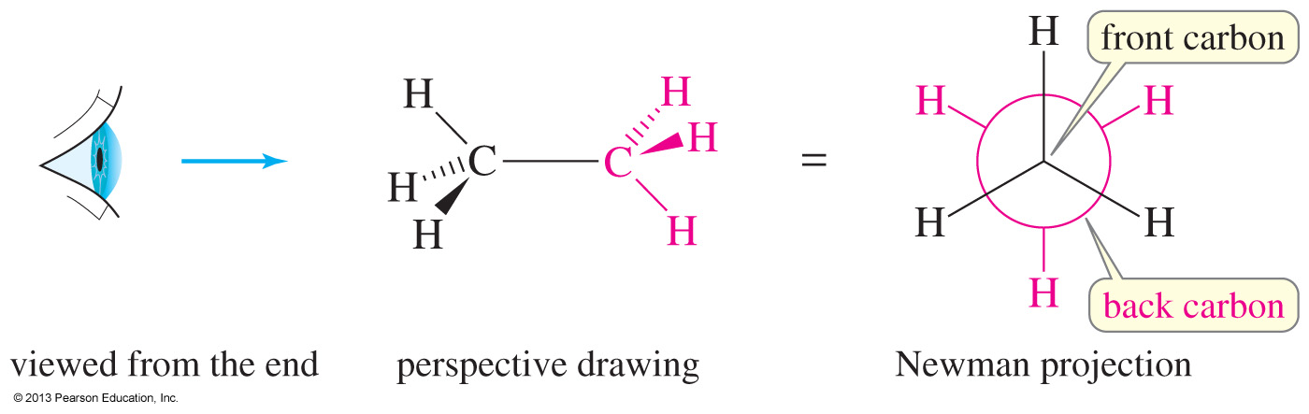
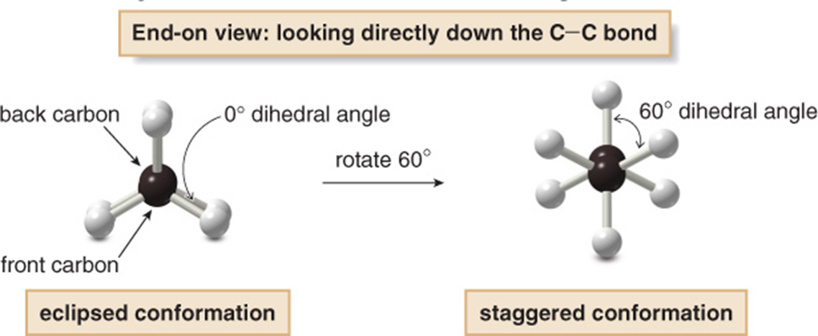
Newman Projections
The Newman projection is a convenient way to judge the stability of the different conformations of a molecule.
Rotating the atoms on one carbon by 60° converts an eclipsed conformation into a staggered conformation, and vice versa.

Slide 14
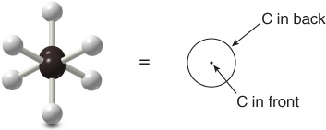
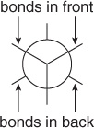
How to Draw Newman Projections
Step 1. Look directly down the C—C bond (end-on), and draw a circle with a dot in the center to represent the carbons of the C—C bond.
Step 2. Draw in the bonds.
Draw the bonds on the front C as three lines meeting at the center of the circle.
Draw the bonds on the back C as three lines coming out of the edge of the circle.

Slide 15
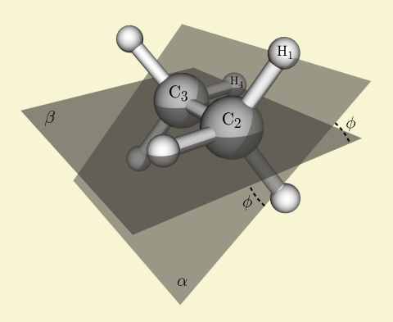
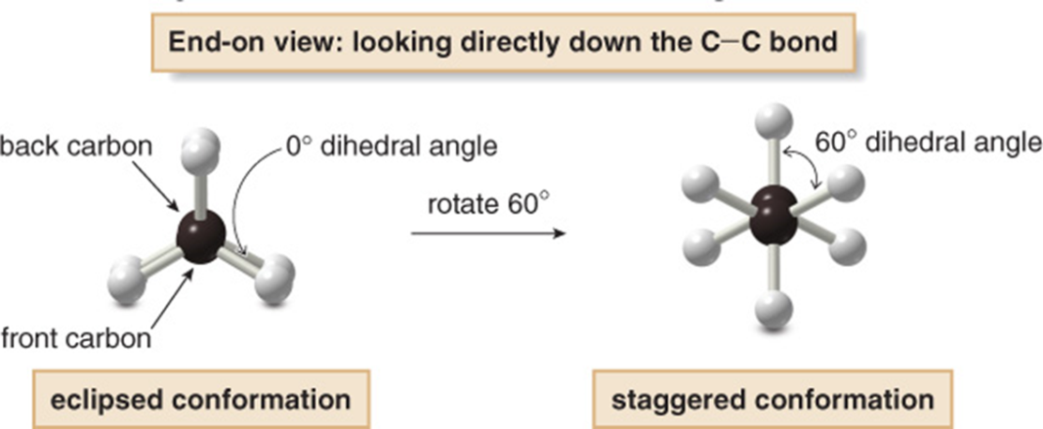
Dihedral Angle
Dihedral angle is the angle between two intersecting planes.
For example, the angle φ is the dihedral angle between the H₁-C₂-C₃ plane and the C₂-C₃-H₄ plane.
In Newman projections, we can easily tell the dihedral angle by looking at the substituents.

Slide 16
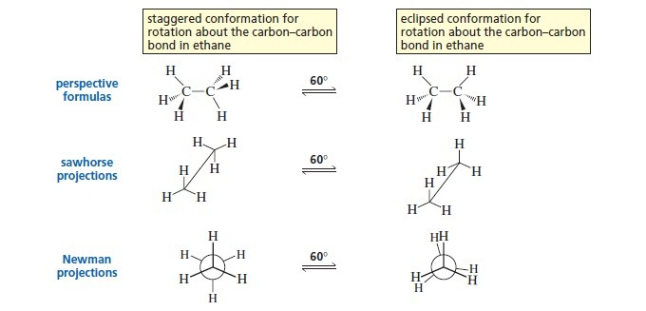
Dihedral Angles and Newman Projections
Torsional angle is an alternative term used for dihedral angle. While dihedral angle is measured from 0-360°, torsional angle is measured from 0-180°, as a positive value in the clockwise direction and a negative value in the anti-clockwise direction.
Among various ways to visualize dihedral angles, Newman projections are the most convenient.

Slide 17
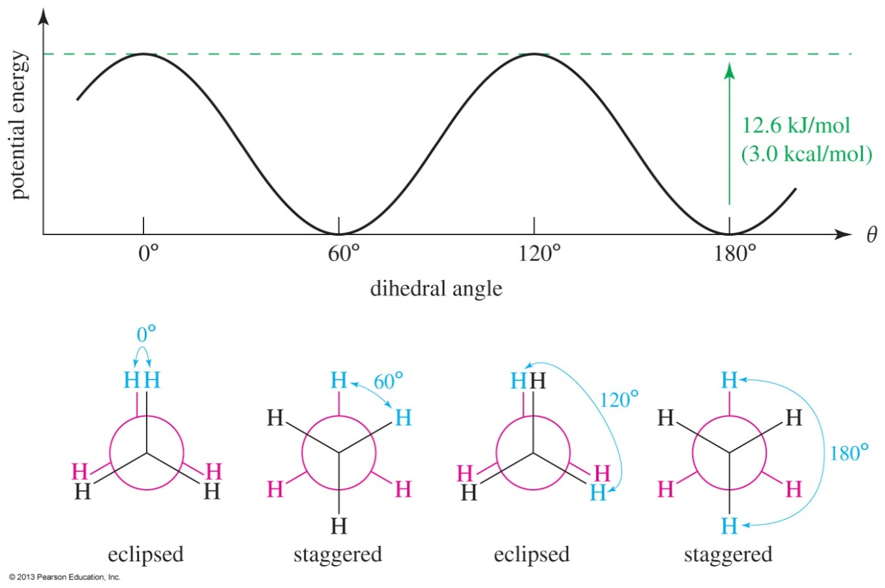
Conformations of Ethane
The torsional energy of ethane is lowest in the staggered conformation. The eclipsed conformation is about 3.0 kcal/mol (12.6 kJ/mol) higher in energy.
At room temperature, this barrier is easily overcome, and the molecules rotate constantly.

Slide 18
Why Eclipsed Conformations are Higher in Energy?
Organic molecules can have many types of strain
Steric - Destabilization due to the repulsion between the electron clouds of atoms or groups. Groups try to occupy some common space.
Torsional - Destabilization due to the repulsion between pairs of bonds caused by the electrostatic repulsion of the electrons in the bonds. Groups are eclipsed.
Angle - Destabilisation due to distortion of a bond angle from it's optimum value caused by the electrostatic repulsion of the electrons in the bonds. e.g. cyclopropane

Slide 19
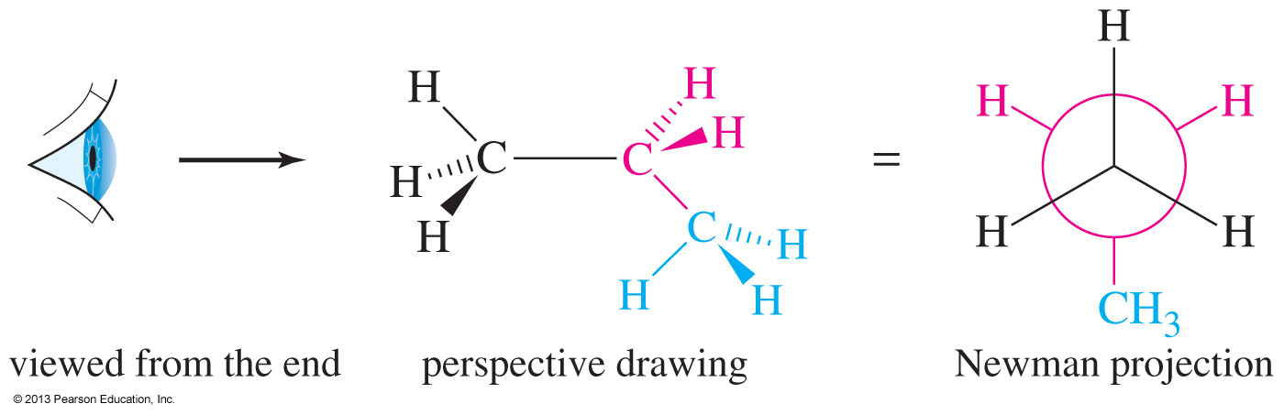
Conformations of Propane
Propane is shown here as a perspective drawing and as a Newman projection looking down the C1—C2 bond.

Slide 20
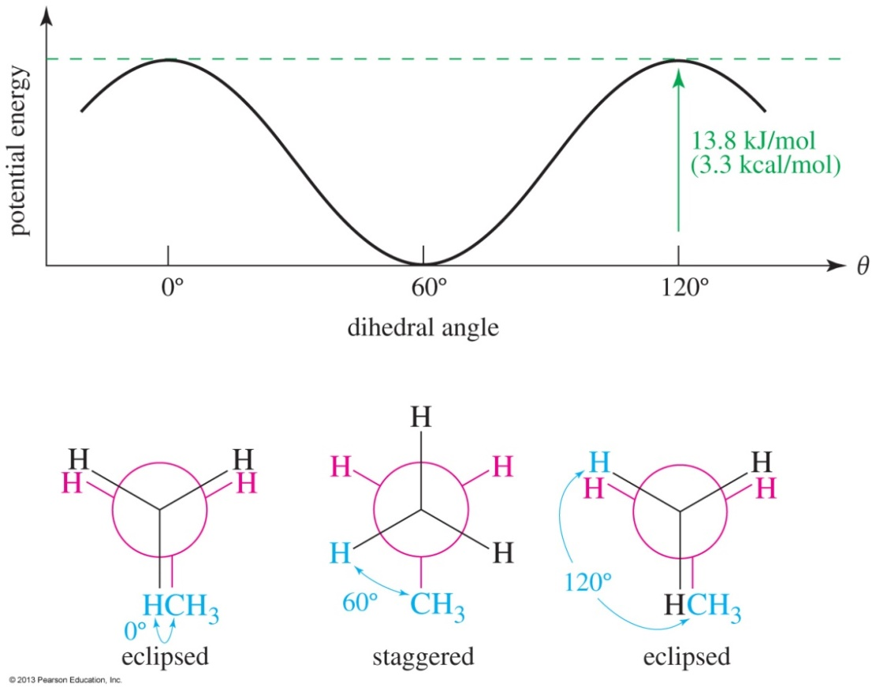
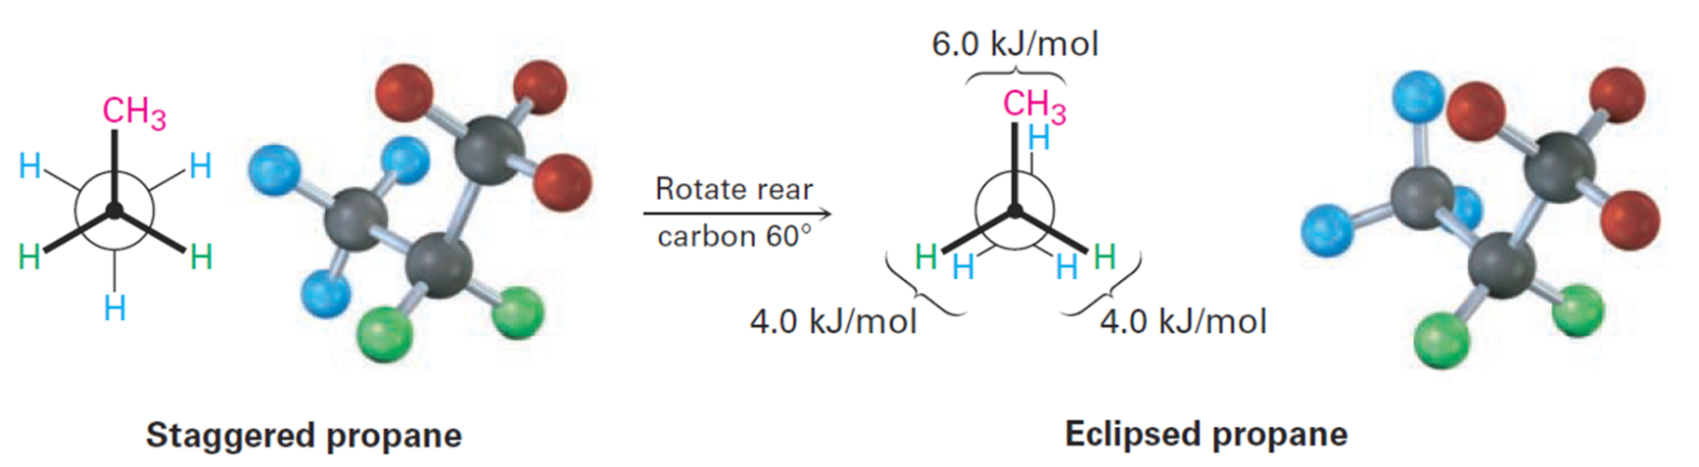
Conformations of Propane
The staggered conformations of propane is lower in energy than the eclipsed conformations. Since the methyl group occupies more space than a hydrogen, the torsional strain will be 0.3 kcal/mol higher for propane than for ethane.

Slide 21
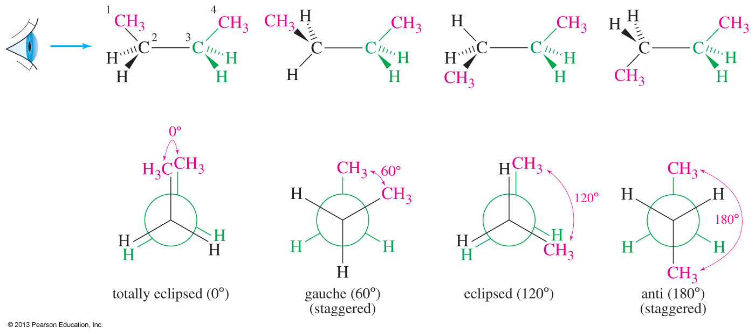
Conformations of Butane
Butane has two different staggered conformations: gauche (60° between the methyl groups) and anti (180°between the methyl groups).
The eclipsed conformation where the dihedral angle between the methyl groups is 0°is referred to as totally eclipsed.

Slide 22
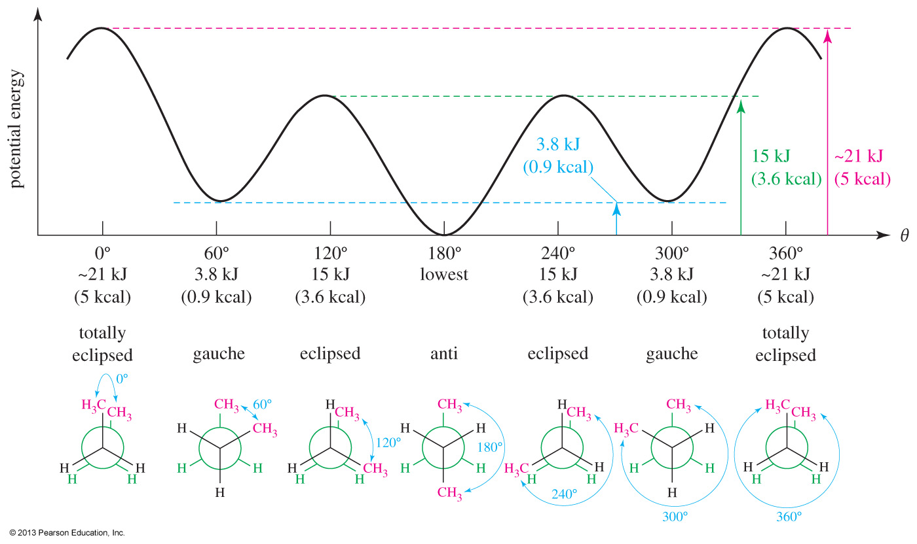
Conformational Analysis of Butane

Slide 23
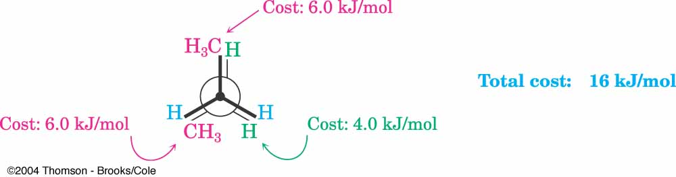
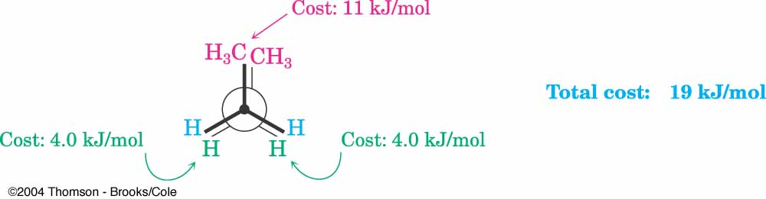
Two Different Eclipsed Conformations in Butane

Slide 24
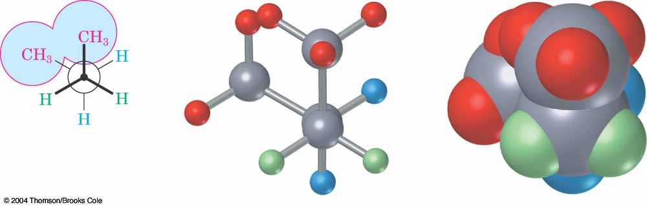
Gauche Interaction in Butane

Slide 25
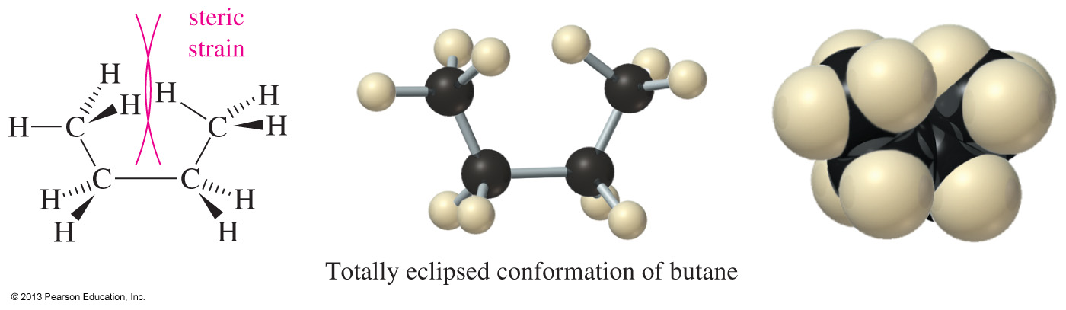
Steric Strain in Butane
The totally eclipsed conformation is higher in energy because it forces the two end methyl groups so close together that their electron clouds experience a strong repulsion.
This kind of interference between two bulky groups is called steric strain or steric hindrance.

Slide 26
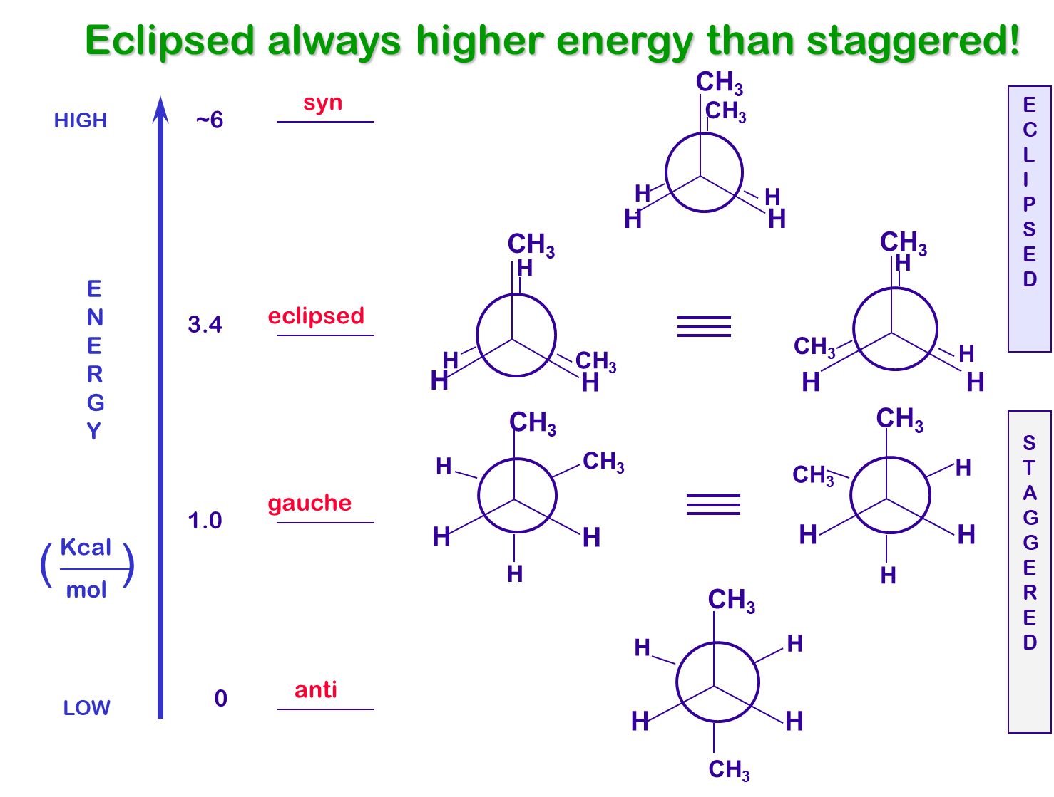
Terminology for Relationship between Substituents
Anti - Description given to two substitutents attached to adjacent atoms when their bonds are at 180º with respect to each other.
Syn - Description given to two substitutents attached to adjacent atoms when their bonds are at 0º with respect to each other.
Gauche - Description given to two substitutents attached to adjacent atoms when their bonds are at 60º with respect to each other.

Slide 27
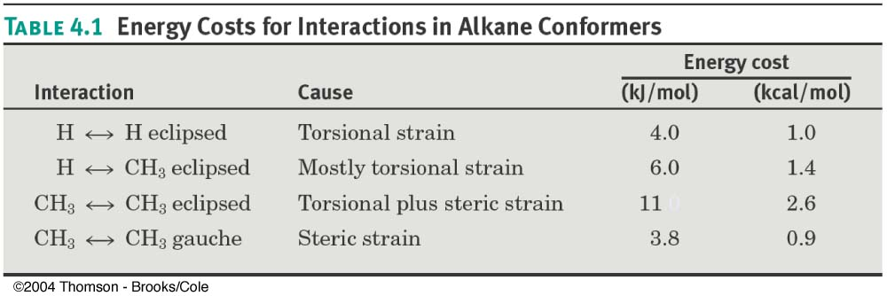
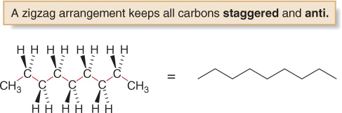
Strain Energies
The energy difference between the lowest and highest energy conformations is called a barrier to rotation.
Since the lowest energy conformation has all bonds staggered and all large groups anti, alkanes are often drawn in zigzag skeletal structures to indicate this.

Slide 28
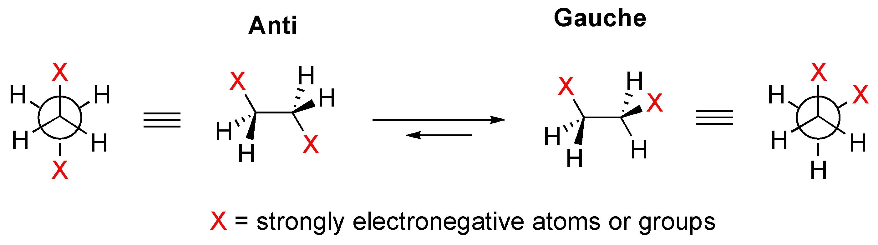
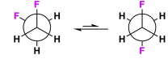
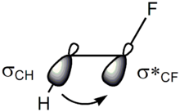
Gauche Effect
The Gauche effect denotes the existence of a gauche conformer, which is more stable than the anti conformer.
Most famous example is 1,2-difluoroethane (CH₂FCH₂F) for which the gauche conformation is more stable by 3.4 kJ/mol. Another example is 1,2-dimethoxyethane.
The increased stability of the gauche conformer is explained based on the possibility of hyperconjugation between C-F and C-H bonds. This is made possible due to the very high electronegativity of fluorine.
C–H σ orbital is a better electron donor and
C–F σ* orbital is a better electron acceptor.
Only the gauche conformation allows good overlap
between these orbitals.

Slide 29
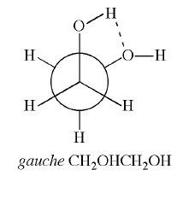
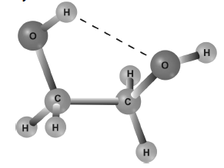
Intramolecular Hydrogen Bonding
Intramolecular H-bonding between two vicinal groups confers an appreciable amount of stability (8-20 kJ/mol) to a conformer.
For effective Intramolecular H-bonding to occur, the donor and the acceptor groups must be close to each other, which is possible only in the eclipsed or gauche conformation.
The gauche conformations with a torsion angle of 60-70° between the interacting groups are ideally suited for intramolecular H-bonding.
In general, 2-substituted ethanols of the type, X-CH₂-CH₂-OH, where X=OH, NH₂, F, Cl, Br, OCH₃, NHCH₃, N(CH₃)₂ etc. have the preferred gauche conformations with OH and X forming intramolecular H-bonds. Usually the dihedral angle is slightly greater than 60°.

Slide 30
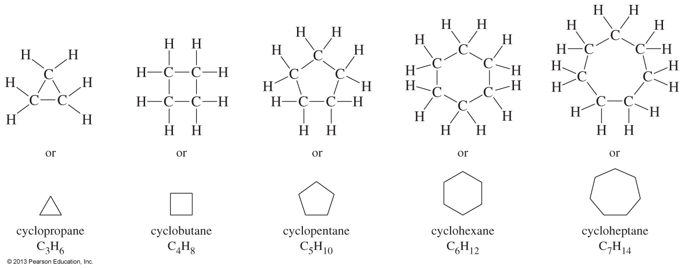
Conformations of Cycloalkanes
Besides torsional strain and steric strain, the conformations of cycloalkanes are also affected by angle strain.
Angle strain is an increase in energy when bond angles deviate from the optimum tetrahedral angle of 109.5°.
The Baeyer strain theory was formulated when it was thought that rings were flat. It states that larger rings would be very highly strained, as their bond angles would be very different from the optimum 109.5°.
It turns out that cycloalkanes with more than three C atoms in the ring are not flat molecules. They are puckered to reduce strain.

Slide 31
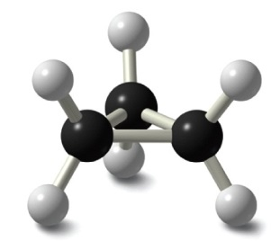


Real Shapes of Cycloalkanes
“flat” “bent” “envelope” “chair”

Slide 32


Strain Energies of Cycloalkanes

Slide 33




Cyclopropane
Planar structure
Bond angles of 60°
Requires that sp³ based bonds are bent
Angle Strain!
Bent bonds = weak bonds
All C-H bonds are eclipsed
Torstional strain!

Slide 34


Cyclobutane
Less angle strain than cyclopropane
More torsional strain
larger number of ring hydrogens
Slightly bent out of plane
One carbon atom is about 25°out of
the plane
Increases angle strain but decreases
torsional strain
Flat structure would have 8 H-H
eclipsing interactions!

Slide 35


Cyclopentane
Conformations of cyclopentane are nonplanar
reduces torsional strain
Planar cyclopentane would have almost no
angle strain but very high torsional strain
Envelope
Four carbon atoms plane
The fifth carbon atom is above or below the plane

Slide 36


Cyclohexane
Cyclohexane, the true Lord of the Rings (in organic chemistry; mastering it will give you great power indeed!)
Lord of the Rings in Middle Earth. The bearer has immense power, but it’s all fantasy.

Slide 37




Cyclohexane
Substituted cyclohexanes occur widely in nature
Menthol
Morphine
If cyclohexane ring were flat, there would be angle strain as well as torsional strain….BUT it has none!

Slide 38


Cyclohexane Conformation
In reality, cyclohexane adopts a puckered “chair” conformation, which is more stable than any possible other conformation.
The chair conformation is so stable because it eliminates angle strain (all C—C—C angles are 109.5°), and torsional strain (all hydrogens on adjacent C atoms are staggered).

Slide 39

How to Draw Cyclohexane Chair Conformation
Step 1 Draw two parallel lines, slanted downward and slightly offset from each other. This means that four of the cyclohexane carbons lie in a plane.
Step 2 Place the topmost carbon atom above and to the right of the plane of the other four, and connect bonds.
Step 3 Place the bottommost carbon atom below and to the left of the plane of the middle four, and connect the bonds. Note that the bonds to the bottommost carbon atom a parallel to the bonds to the topmost carbon.

